Slide 1

Spotify - Trend analysis with Recommendation system

Slide 2
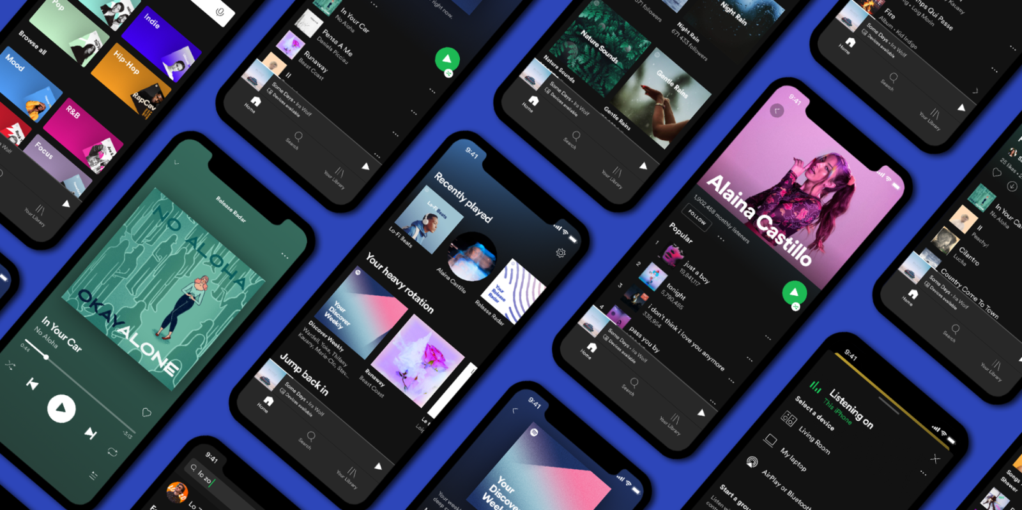
Problem Statement:
Customers face exhaution searching for their preferred music
Unavailability of user-ratings or song-ratings data can limit recommendation engine
Project Goal:
Identify the most popular genres and songs on Spotify by understanding how have their popularity trends changed over time
Recommend a particular song or artist, based on the features of the songs and the user listening history
Enhance the user experience, increase engagement, and revenue by providing personalized music recommendations
INTRODUCTION

Slide 3
Data Cleaning : Removed the Duplicate Songs by Same Artist and took only entry with Maximum popularity
Exploratory Data Analysis to see the music feature trends
Used K-means to make clusters based on genres and song features
Cosine Similarity to classify and recommend songs
EXECUTION FLOW

Slide 4
Data Description
The data used in this project is the Spotify song dataset, which contains metadata and audio features for over 170K songs which after cleaning remained 157K
Song data includes information about each particular song, such as the song title, artist, album, release date, duration, and audio features such as tempo, loudness, and key.
Genre data includes information about the different genres and sub-genres of music.
Data_by_artist includes information about each artist such as number of songs, duration of songs, loudness, tempo and popularity

Slide 5
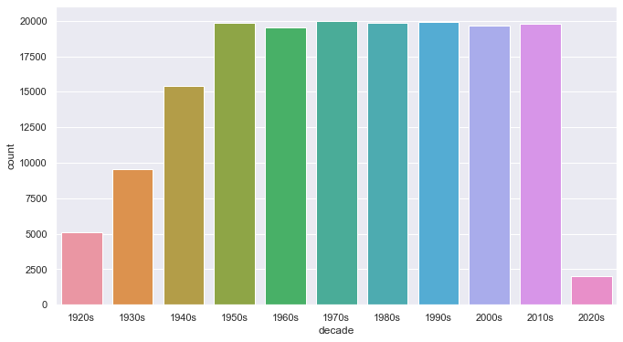
NUMBER OF SONGS OVER THE DECADES
Number of songs are consistent since 1950s and there is very less Temporal Bias in the Dataset

Slide 6
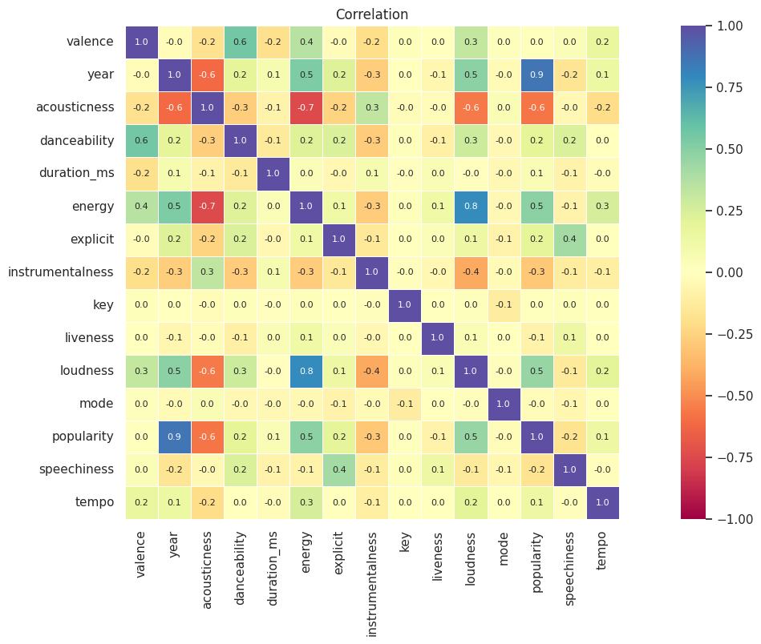
CORRELATION ANALYSIS
Strong positive correlation:
Valence Danceability
Negative correlation:
Energy .Acousticness
High correlation:
Acousticness Popularity and Loudness

Slide 7
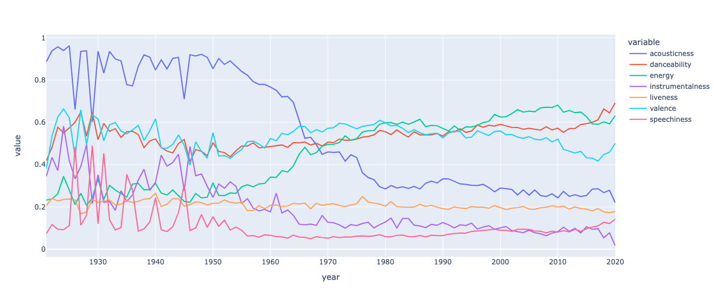
TREND ANALYSIS
Increases in both loudness and energy
Decrease in the acousticness
Liveness and speechiness remain constant.
Valence, has shown some fluctuations over time

Slide 8
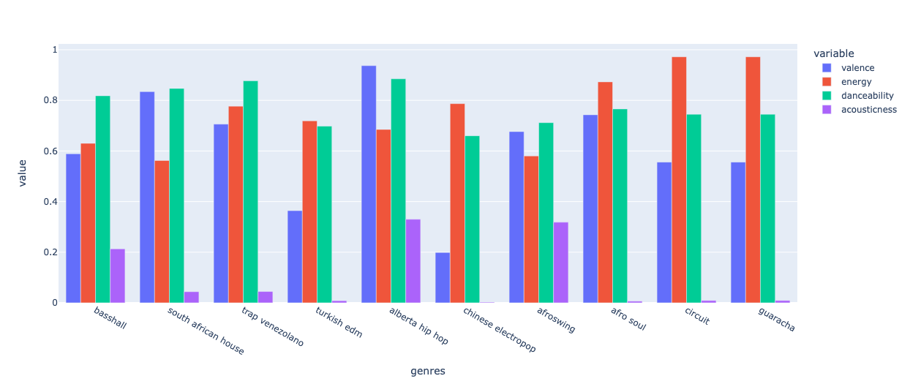
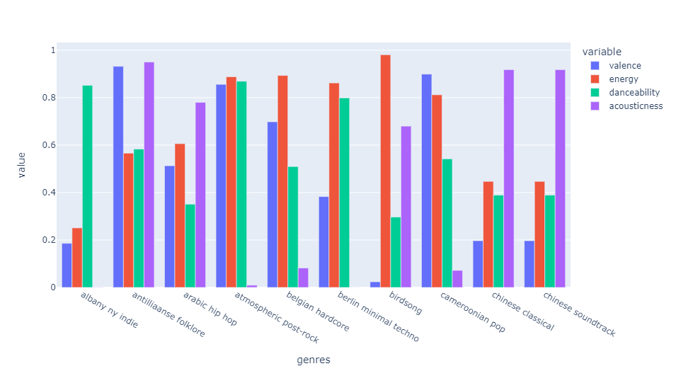
MUSIC FEATURES IN TOP 10 GENRES
This observation aligns with the broader trend of decreasing acousticness in the music industry over the past century.
ANALYZING BOTTOM 10 GENRE SONGS
We found a clear decline in acousticness over time, reflecting a shift in the music industry's preferences and trends.

Slide 9
K-means Clustering
We applied the K-means clustering algorithm to group similar songs together and gain insights on how to select appropriate features and models for the system.
The songs have been grouped into clusters based on their genres and later by songs features.
Enhance our understanding of the data by visualizing these clusters in a 2D space as well as 3D space.

Slide 10
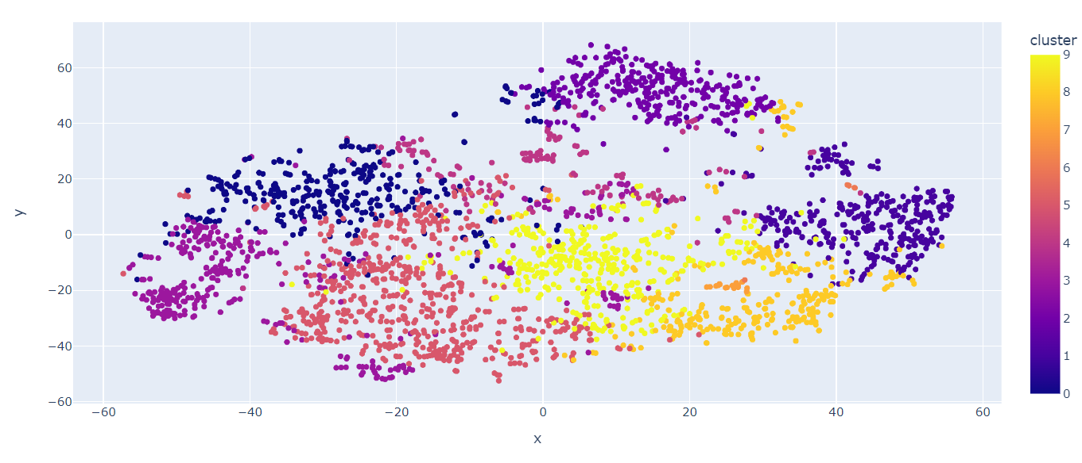
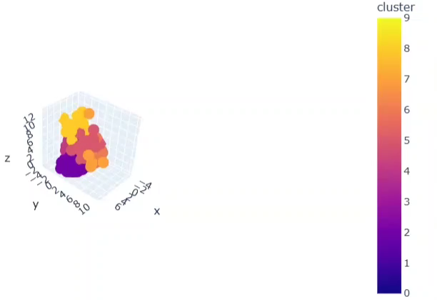
Songs belonging to same genre or having similar features become a part of the same cluster Through PCA we created 3 components to visualize different genre clusters
Genre Clustering

Slide 11
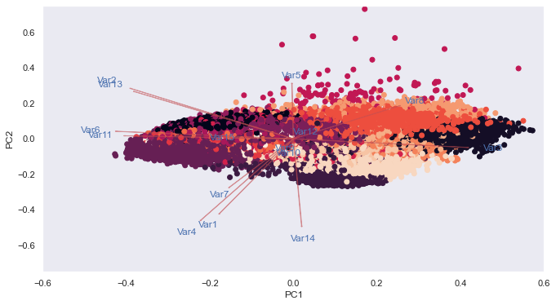
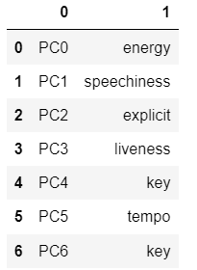
Songs having similar features become a part of the same cluster
Song Clustering
Different Music components contribute to successive Principal components.

Slide 12
Background - Spotify Recommendation System
Spotify relies on collaborative filtering algorithms to deliver music recommendations
Collaborative filtering uses historical data from user ratings/ product ratings to predict user preferences.
This method can also be applied to songs with overlapping listener groups.
However, collaborative filtering has its limitations, particularly in recommending new or unpopular music
To overcome these limitations, Spotify has begun exploring alternative approaches, such as content-based filtering.
Another existing module relevant to the Spotify recommendation system is the "Surprise" library in Python. This library provides a range of algorithms for collaborative filtering

Slide 13
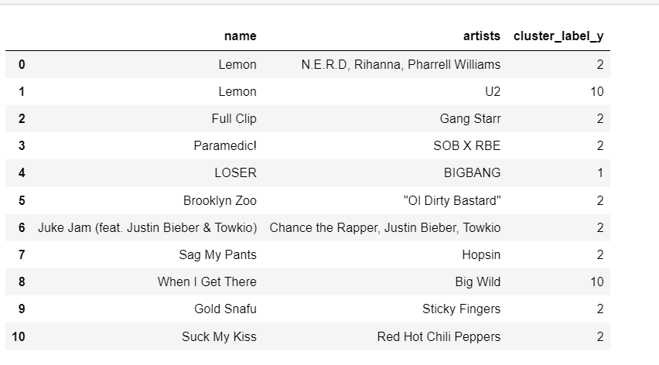
Recommendation System - Approach
Test Song ‘ Lemon’ by N.E.R.D
7 out of 10 recommended songs (index 1 to 10) belong to same cluster (2) as Test song.
Unable to develop collaborative filtering since no user-ratings or song-ratings data was available
Selected top 50K songs based on popularity.
Found the cosine similarity of “Test” Song (proxy to song user prefers) to all 50K songs
Sorted songs in ascending order of Cosine Similarity and decreasing order of Popularity to recommend the first 10
Identified the cluster of recommended songs assigned through K Means clustering to gauge the quality of recommendations

Slide 14
Outcome of Recommendation Engine
Developing advanced marketing strategies
Help music industry professionals and businesses gain insights into consumer behavior and preferences
Improving sales by devising marketing strategies based on emerging trends
Personalized music recommendations can lead to increased user engagement, loyalty, and revenue for Spotify
Spotify can differentiate itself from its competitors, ultimately leading to increased revenue for the platform.

Slide 15

Conclusion
Using data analysis, the study observed how certain song features, such as acousticness, energy, and loudness, have evolved over time.
K-means clustering was then applied to group songs based on their characteristics, highlighting the diversity in music genres.
Recommendation system, built on cosine similarity and popularity, was developed to efficiently suggest songs for users, with the effectiveness demonstrated through cluster labels of test and recommended songs.

Slide 16
Thank You !

